Slide 1
Practice 10:
Integrated Value Creation
Miguel Ángel González Álvarez
Emilly Noelia Villacís Recalde
Quinten Woumans
Edoardo Anfelli
Stokely Ross

Slide 2
Takeaways
Consumer Staples offer stability with modest impacts, Materials present high risk and reward with significant environmental trade-offs, and Communication Services offer high volatility with substantial potential for both gains and losses across financial, environmental, and social dimensions.
We recommended projects mostly in the Communication Services industry to the Pension Fund.

Slide 3
01
02
INDUSTRY DIFFERENCES
PROJECT RANKING
03
04
BEST & WORST PROJECTS
PENSION FUND RECOMMENDATION
A, B & C
Traditional, SIV & IVC
A, B & C
Allianz Pensionskasse Aktiengesellschaft

Slide 4
01
INDUSTRY DIFFERENCES
A, B & C

Slide 5



FINANCIAL, ENVIRONMENTAL AND SOCIAL IMPACTS ACROSS INDUSTRIES
MATERIALS (B)
CONSUMER STAPLES (A)
COMMUNICATION SERVICES (C)
KEY DIMENSIONS
Essential goods like food and hygiene products
Resource extraction and commodity production
Digital services and infrastructure
Impact on each factor
Volatility of cash flows

Slide 6
FINANCIAL INSIGHTS BY INDUSTRY
CONSUMER STAPLES (A) Stable but low returns (Mean = 0.78, STD = 16.96)
MATERIALS (B) High returns with high risk (Mean = 7.29, STD = 40.02)
COMMUNICATION SERVICES (C) Moderate mean, highest volatility (Mean = 4.06, STD = 82.51)

Slide 7
ENVIRONMENTAL INSIGHTS BY INDUSTRY
CONSUMER STAPLES (A) Positive mean, low variability
MATERIALS (B) Negative mean, high variability (Mean = -4.56, STD = 72.37)
COMMUNICATION SERVICES (C) Mixed results, extreme variability (Mean = 2.62, STD = 124.4)

Slide 8
SOCIAL INSIGHTS BY INDUSTRY
CONSUMER STAPLES (A) Negative mean, low variability (Mean = -2.73, STD = 22.98)
MATERIALS (B) Positive mean, moderate variability (Mean = 2.89, STD = 50.89)
COMMUNICATION SERVICES (C) Most negative mean, highest variability (Mean = -4.84, STD = 104.4)

Slide 9
FINANCIAL, ENVIRONMENTAL AND SOCIAL IMPACTS ACROSS INDUSTRIES
CONSUMER STAPLES (A) ← Predictable nature ← driven by consistent demand
MATERIALS (B) ← Balance financial gains with environmental challenges and community impact
COMMUNICATION SERVICES (C) ← Innovation brings opportunities and risks, especially in social dimensions like equity and misinformation ⇒ double edge sword
Understanding these differences ⇒ Smarter investment decisions aligned with financial and ESG goals

Slide 10
02
PROJECT RANKING
Traditional finance, SIV & IMC

Slide 11
RANKING CRITERIA
MAXIMIZATION OF FINANCIAL VALUE, F : Maximizing the return of each project
MAXIMIZATION OF SIMPLE INTEGRATED VALUE, SIV : Integration of financial, social and environmental impacts equally.
SIV = F+S+E
MAXIMIZING INTEGRATED VALUE CREATION :
IVC = {(F+) + (β*S+) + (γ*E+)} + δ {(F–) + (β*S–) + (γ*E–)}

Slide 12
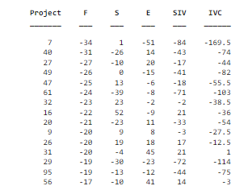
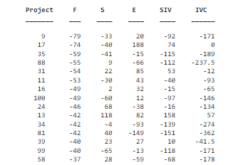
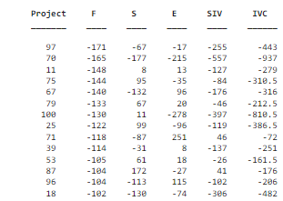
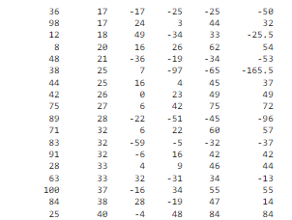
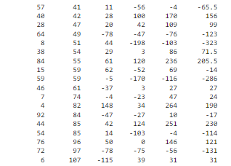
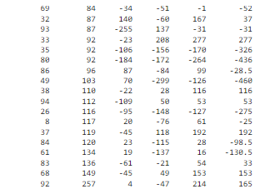
F
WORST
A
B
C
BEST

Slide 13
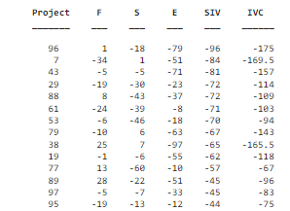
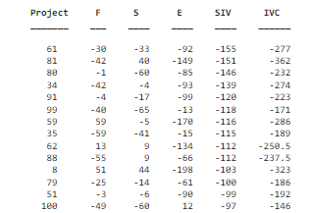
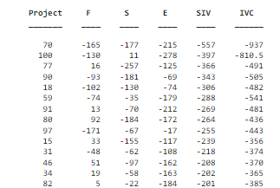
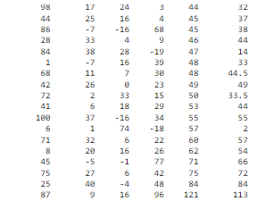
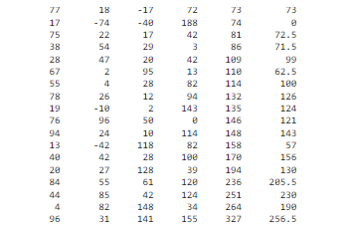
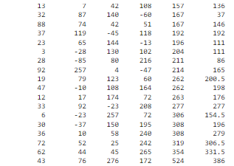
SIV
WORST
A
B
C
BEST

Slide 14
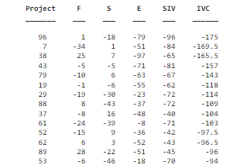
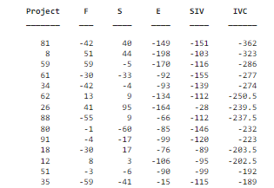
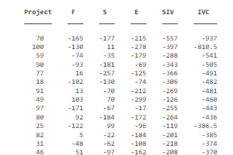
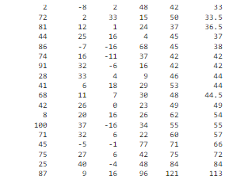
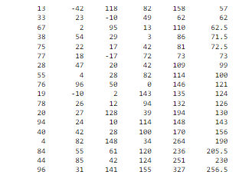
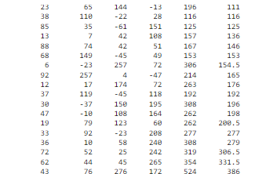
IVC
WORST
A
B
C
BEST

Slide 15
03
BEST & WORST PROJECTS
A, B & C

Slide 16
FINDINGS
FINANCIAL VALUE
CONSUMER STAPLES (A)
Best Project: 25 with F = 40
Consistent demand for staples and cost-efficient operations, ensuring high profitability despite minimal social and environmental contributions
Worst Project: 7 with F = -34
Might face declining sales, high costs, or operational inefficiencies, contributing to its financial losses.

Slide 17
FINDINGS
FINANCIAL VALUE
MATERIALS (B)
Best Project: 6 with F = 107
Likely benefiting from favorable commodity prices or efficient extraction methods
Achieves a significantly higher financial return compared to others in the sector.
Worst Project: 9 with F = -79
Likely affected by unfavorable commodity prices, high operational costs, or environmental liabilities, resulting in a poor financial outcome.

Slide 18
FINDINGS
FINANCIAL VALUE
COMMUNICATION SERVICES (C)
Best Project: 92 with F = 257
Highly scalable service or product, possibly linked to innovative technology with widespread adoption
Worst Project: 97 with F = -171
Significant financial losses could stem from failed technological implementation, high competition, or lack of market adoption.

Slide 19
FINDINGS
SIV
CONSUMER STAPLES (A)
Best Project: 87 with SIV = 121
Balanced contributions across financial, social, and environmental dimensions elevate the overall value of this project
Worst Project: 96 with SIV = -96
Negative contributions in social and environmental impacts, combined with negative financial returns

Slide 20
FINDINGS
SIV
MATERIALS (B)
Best Project: 96 with SIV = 327
Strong contributions to social and environmental dimensions, possibly through sustainable practices and community benefits.
Worst Project: 61 with SIV = -155
Negative financial and environmental impacts highlight the risks and inefficiencies associated with this project.

Slide 21
FINDINGS
SIV
COMMUNICATION SERVICES (C)
Best Project: 43 with SIV = 524
Exceptional environmental contributions (276) combined with strong financial and social impactsogy with widespread adoption
Best project according to SIV and IVC
Worst Project: 70 with SIV = -557
Severe environmental and social penalties, along with financial underperformance, make this project the worst in its sector.

Slide 22
FINDINGS
IVC
CONSUMER STAPLES (A)
Best Project: 87 with IVC = 113
Effectively balances positive impacts across all dimensions while minimizing negative contributions, aligning with the IVC formula weighted approach.
Worst Project: 96 with IVC = -175
Inability to generate positive impacts in any dimension leads to substantial penalties under the IVC criterion

Slide 23
FINDINGS
IVC
MATERIALS (B)
Best Project: 96 with IVC = 256.5
Outstanding performance in social (141) and environmental (155) dimensions, coupled with moderate financial returns, makes this project a top choice under IVC.
Worst Project: 81 with IVC = -362
Negative financial and environmental impacts significantly outweigh any positive contributions, resulting in a poor IVC score.

Slide 24
FINDINGS
IVC
COMMUNICATION SERVICES (C)
Best Project: 43 with IVC = 386
Exceptional contributions to environmental and social impacts (total 352) elevate this project’s IVC score, showcasing its alignment with sustainability goals.
Worst Project: 70 with IVC = -937
Severe penalties for extreme negative social (-177) and environmental (-165) impacts, combined with financial losses, make this the worst project overall (SIV and IVC)

Slide 25
 | PROJECT | F | S | E | SIV | IVC
F_A_BEST | 25 | 40 | -4 | 48 | 84 | 84
F_A_WORST | 7 | -34 | 1 | -510 | -84 | -169,5
F_B_BEST | 6 | 107 | -115 | 39 | 31 | 31
F_B_WORST | 9 | -79 | -33 | 20 | -92 | -171
F_C_BEST | 92 | 257 | 4 | -47 | 214 | 165
F_C_WORST | 97 | -171 | -67 | -17 | -255 | -443
SIV_A_BEST | 87 | 9 | 16 | 96 | 121 | 113
SIV_A_WORST | 96 | 1 | -18 | -79 | -96 | -175
SIV_B_BEST | 96 | 31 | 141 | 155 | 327 | 256,5
SIV_B_WORST | 61 | -30 | -33 | -92 | -155 | -277
SIV_C_BEST | 43 | 76 | 276 | 172 | 524 | 386
SIV_C_WORST | 70 | -165 | -177 | -215 | -557 | -937
IVC_A_BEST | 87 | 9 | 16 | 96 | 121 | 113
IVC_A_WORST | 96 | 1 | -18 | -79 | -96 | -175
IVC_B_BEST | 96 | 31 | 141 | 155 | 327 | 256,5
IVC_B_WORST | 81 | -42 | 40 | -149 | -151 | -362
IVC_C_BEST | 43 | 76 | 276 | 172 | 524 | 386
IVC_C_WORST | 70 | -165 | -177 | -215 | -557 | -937

Slide 26
04
PENSION FUND RECOMMENDATION
Allianz Pensionskasse Aktiengesellschaft

Slide 27
RECOMMENDED PROJECTS TO ALLIANZ PENSIONSKASSE AKTIENGESELLSCHAFT
INDUSTRY | PROJECT | F | S | E | SIV | IVC
C | 43 | 76 | 276 | 172 | 524 | 386
C | 62 | 44 | 45 | 265 | 354 | 331,5
C | 72 | 52 | 25 | 242 | 319 | 306,5
C | 36 | 10 | 58 | 240 | 308 | 279
C | 33 | 92 | -23 | 208 | 277 | 277
B | 96 | 31 | 141 | 155 | 327 | 256,5
B | 44 | 85 | 42 | 124 | 251 | 230
A | 87 | 9 | 16 | 96 | 121 | 113
A | 25 | 40 | -4 | 48 | 84 | 84

Slide 28
WHY THESE PROJECTS?
Assumption: Investment preferences align with following parameters for the IVC
Beta = 0.5
Represents the emphasis placed on social value (S) in the integrated valuation.
Implies that social value is weighted moderately—half as important as financial or ecological value in this context. The company values social impacts but not as much as financial or ecological aspects.
Gamma = 1
Represents the weight assigned to ecological value (E).
Indicates that ecological value is considered equally important as financial value. The company gives strong priority to environmental impacts, balancing them with financial outcomes.
Delta = 2
Represents the weighting of negative impacts (financial, social, and ecological).
Implies that negative impacts are penalized twice as much as positive impacts are rewarded. This encourages the company to avoid activities with significant negative consequences, even if they provide some positive outcomes in other areas.

Slide 29
WHY THESE PROJECTS?
Balancing profitability with Sustainability
Use IVC to decide on best projects
Projects must balance financial returns with positive environmental and social impacts.
Negative-impact projects are avoided, even if highly profitable.
High IVC Scores: Preferred projects align with both profitability and ESG commitments.
Long-term horizon and Diversification
Regulatory Alignment: Investments adhere to SFDR requirements, ensuring ethical and sustainable practices.
Fiduciary Responsibility: The fund seeks stable returns that secure pensions while promoting long-term environmental and social value.
Add best projects of other industries (sector A) to support diversification

Slide 30
Thanks!
Do you have any questions?
Please keep this slide for attribution
]]
Miguel Ángel González Álvarez
Emilly Noelia Villacís Recalde
Quinten Woumans
Edoardo Anfelli
Stokely Ross

